Slide 1
Simplified Soft Sphere Collision Model for Fluid-Particle Systems
2017 NETL Workshop on Multiphase Flow Science August 8-9, 2017, Morgantown, USA
Husam Elghannay & Danesh Tafti
Mechanical Engineering Department
Virginia Polytechnic Institute and State University
husam559@vt.edu
dtafti@vt.exchange.edu

Slide 2
Outline
Description of linear SS collision model
Different existing implementation & simplified model
Validation
oblique impact
sphere on wall
Proper implementation
Conclusion

Slide 3
Linear SS Collision Model
${\vec{F}}_{n}=\left\{\begin{aligned}\begin{aligned}k_{n}{\vec{δ}}_{n}−η_{n}{\vec{u}}_{n } \\ \end{aligned} forΔ>0 \\ 0 else\end{aligned}\right.$
${\vec{F}}_{t}=\left\{\begin{aligned}\begin{aligned}−k_{t}{\vec{δ}}_{t}−η_{t}{\vec{u}}_{t } \\ \end{aligned} for |k_{t}{\vec{δ}}_{t}+η_{t}{\vec{u}}_{t}|<μ_{f}\left|{\vec{F}}_{n}\right| \\ {−μ}_{f}\left|{\vec{F}}_{n}\right| else\end{aligned}\right.$
${\vec{δ}}_{n}=Δ\vec{n}$
${\vec{u}}_{n}=\left(\vec{u}.\vec{n}\right)\vec{n}$
${\vec{u}}_{t}=\vec{u}−{\vec{u}}_{n}−\vec{ω}×\vec{n}$
${\vec{δ}}_{t}^{n}={\vec{δ}}_{t}^{n−1}+\int{{\vec{u}}_{t}}dt$
Dashpot (η)
Spring (k)
Slider (F_{t} ≤ μF_{n})
ω
$$\vec{y}$$
$$\vec{n}$$
$${\vec{x}}_{ }$$
Δ

Slide 4
Model Formulation
Different formulations exist when sliding occurs!
${\vec{F}}_{t}={−μ}_{f}\left|{\vec{F}}_{n}\right|\frac{k_{t}{\vec{δ}}_{t}+η_{t}{\vec{u}}_{t}}{|k_{t}{\vec{δ}}_{t}+η_{t}{\vec{u}}_{t}|}$ Model A
Can be expressed as ${\vec{F}}_{t}={−μ}_{f}\left|{\vec{F}}_{n}\right|\frac{{\vec{δ}}_{t}}{|{\vec{δ}}_{t}|}$
E.g., Candull & Strack (1979)
${\vec{F}}_{t}={−μ}_{f}\left|{\vec{F}}_{n}\right|\frac{{\vec{u}}_{t}}{|{\vec{u}}_{t}|}$ Model B
E.g., Tsuji et al. (1993)
Can also introduce Model C in which ${\vec{δ}}_{t}^{}=τ_{c} {\vec{u}}_{t}$ along with ${\vec{F}}_{t}={−μ}_{f}\left|{\vec{F}}_{n}\right|\frac{{\vec{u}}_{t}}{|{\vec{u}}_{t}|}$

Slide 5
Oblique Impact Experiment
Experiment by Kharaz et al. (2001)
5 mm Aluminum sphere falls on glass anvil at 3.9 m/s (no initial spin)
Impact angle is changed and rebound (linear and angular) velocities are recorded
Normal impact is nearly elastic
Impact angle
Parameter | value
Density (sphere) | 2200 (kg/m³)
Density (wall) | 2700 (kg/m³)
stiffness coefficient k_{n} | 1000 (N/m)
stiffness coefficient k_{t} | 860 (N/m)
COR | 0.98 (-)
Friction factor | 0.092 (-)
Diameter | 5 (mm)
Time step | 1.13 μs

Slide 6
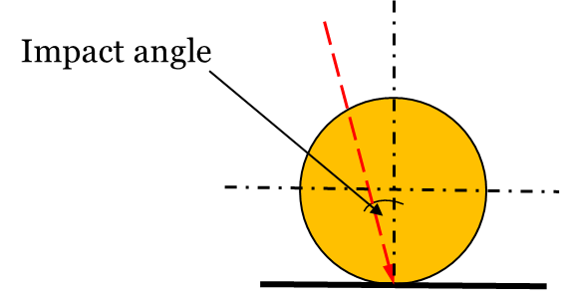
Oblique impact: results
Tangential COR
Rebound angular velocity

Slide 7
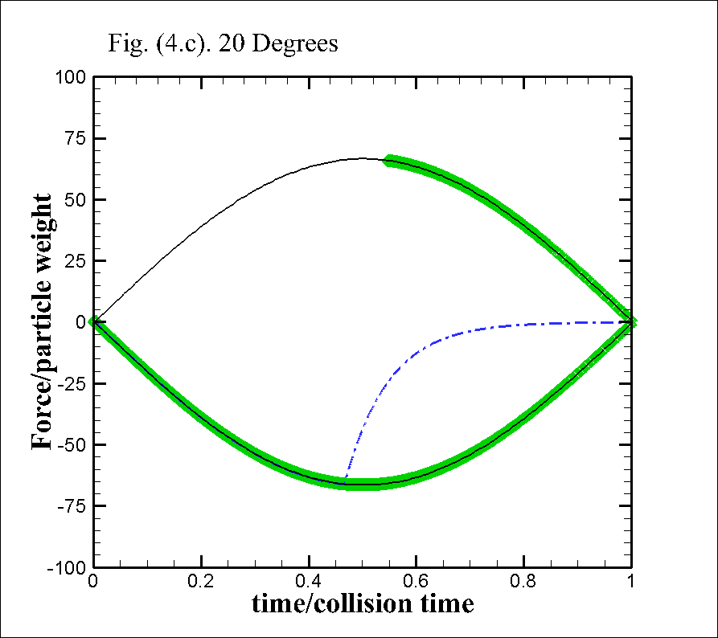
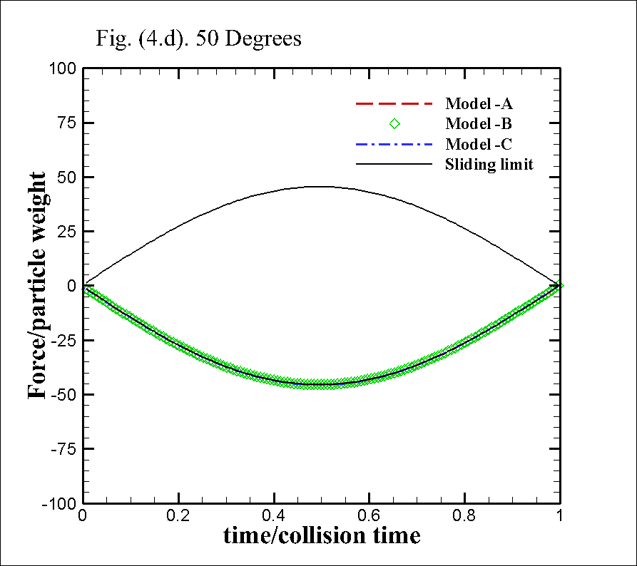
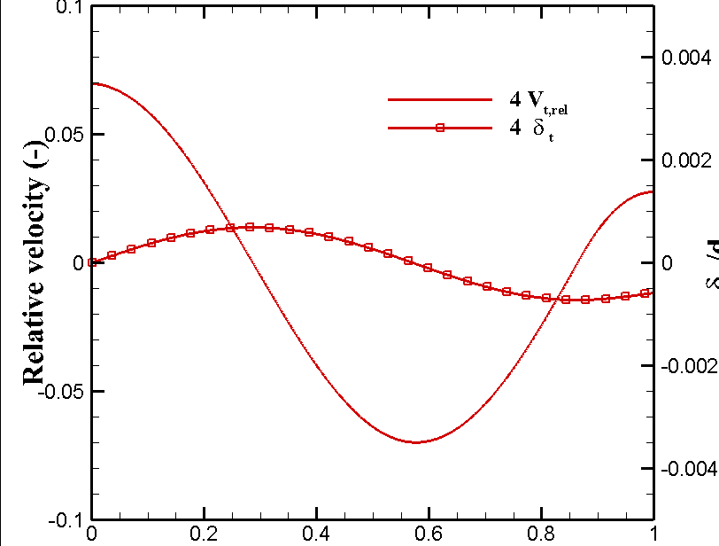
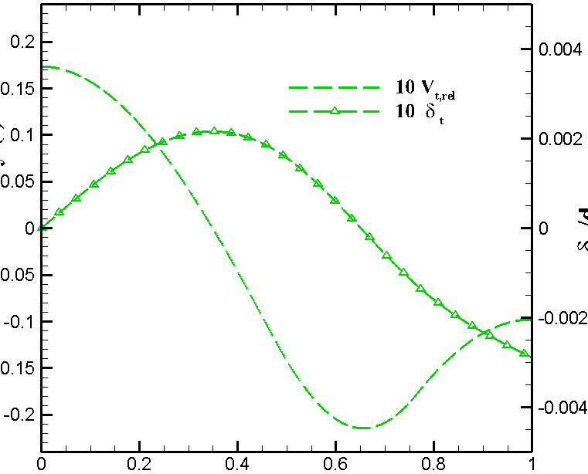
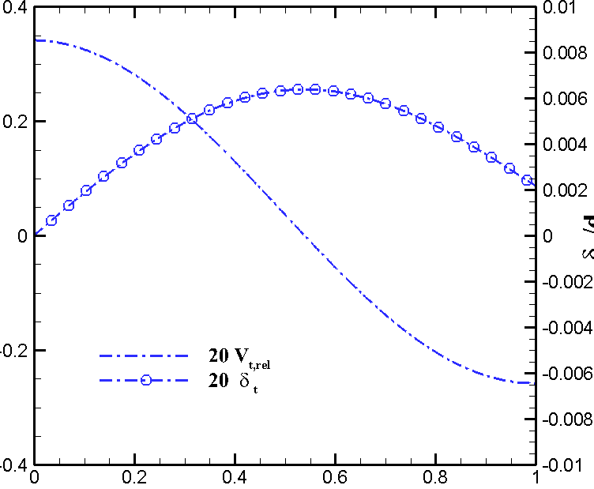
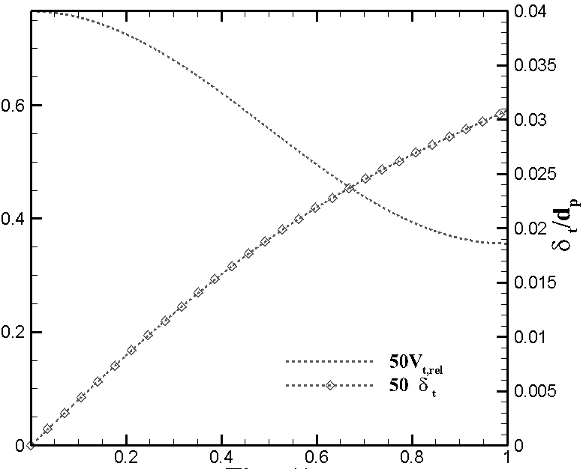
Oblique impact: tangential force pattern

Slide 8
Sphere on Wall
Terminal conditions
u/uo=5/7
w.r/u_{o}=5/7
t_{s}=2u_{o}/(7μg)
Test case:
10 mm sphere traveling on a flat plate with initial velocity of 1 m/s. ρ=2500 f=0.7, μ_{r}=0.0
U_{o},ω_{o}=0
U_{f}=(5/7)U_{o}, ω_{f}r_{p}=(5/7)U_{o}
t_{o}=0
t_{s}
g
μm_{p}g

Slide 9
Sphere on wall: results
Models B &C
Model A

Slide 10
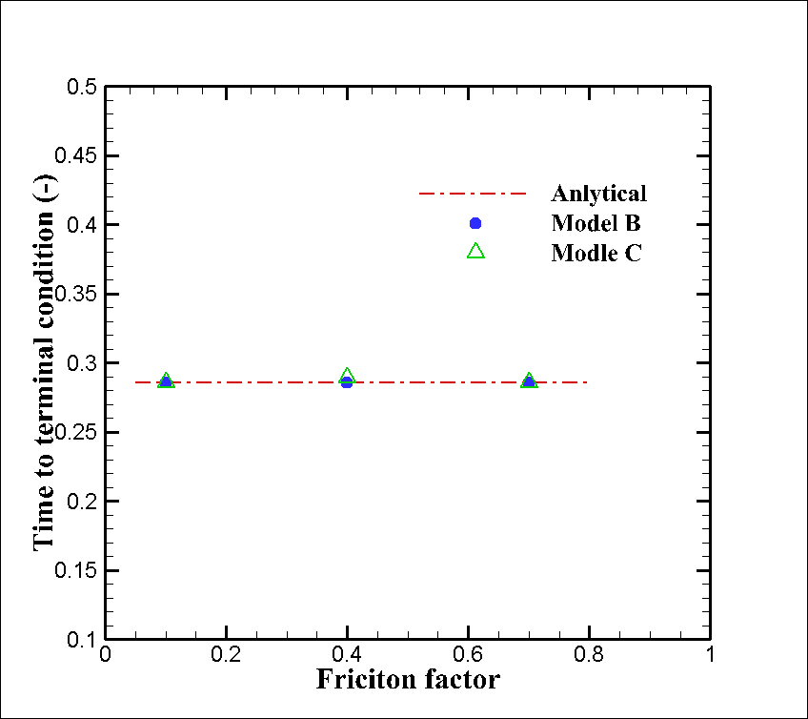
Sphere on wall: results

Slide 11
Proper implementation
Model-AA (proper implementation)
The tangential displacement represents a deformation that should be limited.
Limit the tangential displacement to a maximum of $δ_{t}^{max}= μ\frac{k_{n}}{k_{t}}δ_{n}^{}$
Mentioned by Tsuji (1992)!
Used by Di Renzo & Di Maio (2004)
NOT used by most researchers

Slide 12
Model-AA: oblique impact results

Slide 13
Model-AA: Sphere on wall results

Slide 14
Conclusions
Different existing SS collision model implementation perform differently
Irrespective of storing tangential deformation information, unless the implementation is done properly the tangential results will be incorrect in one way or another
A simplified SS collision model can result in reasonable validation in particle-level validation without the need to store tangential deformation information

Slide 15
Acknowledgement
Libyan Ministry of Higher Education and Scientific Research
Department of Mechanical Engineering at Virginia Tech
Advanced Research Computing (ARC) at Virginia Tech

Slide 16
Thank You

Slide 17
References
Kharaz, A., Gorham, D., & Salman, A. (2001). An experimental study of the elastic rebound of spheres. Powder Technology, 120(3), 281-291.
Tsuji, Yutaka, Toshitsugu Tanaka, and T. Ishida. "Lagrangian numerical simulation of plug flow of cohesionless particles in a horizontal pipe." Powder technology 71.3 (1992): 239-250.
Cundall, P. A., Strack, O.D.L. (1979). A discrete numerical model for granular assemblies. Géotechnique, 29(1), 47-65.
Di Renzo, A., & Di Maio, F. P. (2004). Comparison of contact-force models for the simulation of collisions in DEM-based granular flow codes. Chemical Engineering Science, 59(3), 525-541.

Slide 18
Model-AA: tangential force pattern

Slide 19
Sphere on a Flat Plate
Terminal conditions according to classical Newton’s theory
u/u_{o}=5/7
w.r/u_{o}=5/7
t_{s}=2u_{o}/(7μg)
U_{o},w_{o}=0
U_{f}=(5/7)U_{o}, w_{f}r_{p}=(5/7)U_{o}
t_{o}
t_{f}
g
μm_{p}g
F.Δt=m_{p}Δv
μm_{p}gΔt=m_{p}Δv
t_{f}-t₀=Δt=Δv/(μg)
t_{f}=(2/7)U_{o}/ (μg)

Slide 20
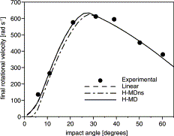
Backup slides
Di Renzo & Di Maio (2004)
Kharaz et al. (2001)

Slide 21
Oblique impact: tangential force pattern
$${\vec{u}}_{t}=\vec{u}−{\vec{u}}_{n}−\vec{ω}×\vec{n}$$
$\vec{ω}×\vec{n}$ >$\vec{u}−{\vec{u}}_{n}$

